Slide 1
Effectively Advising
Undergraduates About Graduate School
Opportunities
Theresa Culley & Debbie Brawn
Nationally Competitive Awards University Honors Program
Biological Sciences
Notes:
Intro – recognizing that everyone in the room is an advisor

Slide 2
©Temple University
Notes:
Advisors play a critical role in guiding students through the undergraduate process. As advisors, our focus is on ensuring that students have a productive undergraduate experience and are able to navigate the system successfully. Examples of advisor responsibilities:
Helping students navigating course choices
Providing support and encouragement
Etc.
In other words, our responsibilities are primarily focused on enhancing student success while they are undergraduates at UC, and much less so on preparing students for what happens afterwards.
Tara’s Talk: Advising Conservations:
Informational (Type 1) – can be delivered with technology
About the Individual Student (Type 2) – passions and interests, strengths, areas of improvement, level and types of engagement in the life of the university
About the Future (Type 3) – Goal-setting and posing questions, What do you want your future to be? What steps do you need to take to make this future a reality? How can we help you reach your goals?
Books: Find Your Why and Callings

Slide 3
Notes:
But can we do a better job of better advising and supporting our students to excel in their careers once they leave their college experience? How can we help them to soar in the next steps of their lives?

Slide 4
Preparing Students for What’s Next
Notes:
Preparing students for what is next
How to engage in the advising/conversation
Grad school is not for everyone – but if so, how do you engage more deeply in that conversation?

Slide 5
What gets you excited?
What do you think about first thing in the morning?
Notes:
What gets you excited?
What do you think about first thing in the morning?
Can you combine your interests?
[Look at the handout and point out some sample questions that advisors can ask of their students]

Slide 6
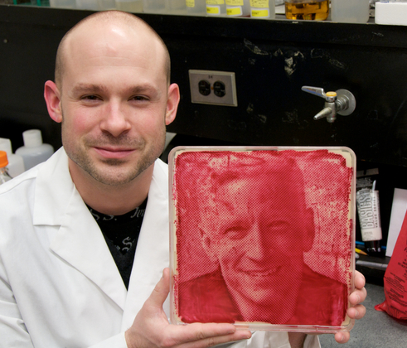
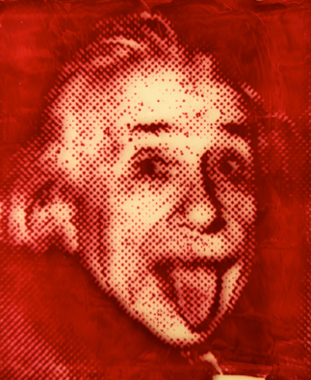
Notes:
Example of a student who followed his passions and combined his interests: Zachary Copfer – a biologist who earned a MFA from DAAP in Film Studies; developed a new film media using E. coli bacteria, called “bacteriography”.

Slide 7
Grad School Basics
Cost: Graduate School can be inexpensive/free
(vs. professional programs)
Salary stipend – GA, TA, RA
Tuition waiver – full or partial
Degree Options:
Doctorate
Masters
Research Based
4-6 yrs
Research Thesis
or
2-3 yrs
Non-Research Thesis
4+1
3+3
Some programs allow B.S. → Ph.D.
Notes:
Go over the grad school basics here:
Graduate school can essentially be free in some fields because of salary stipends and full or partial tuition waivers.
Different degree options with different times, etc.

Slide 8
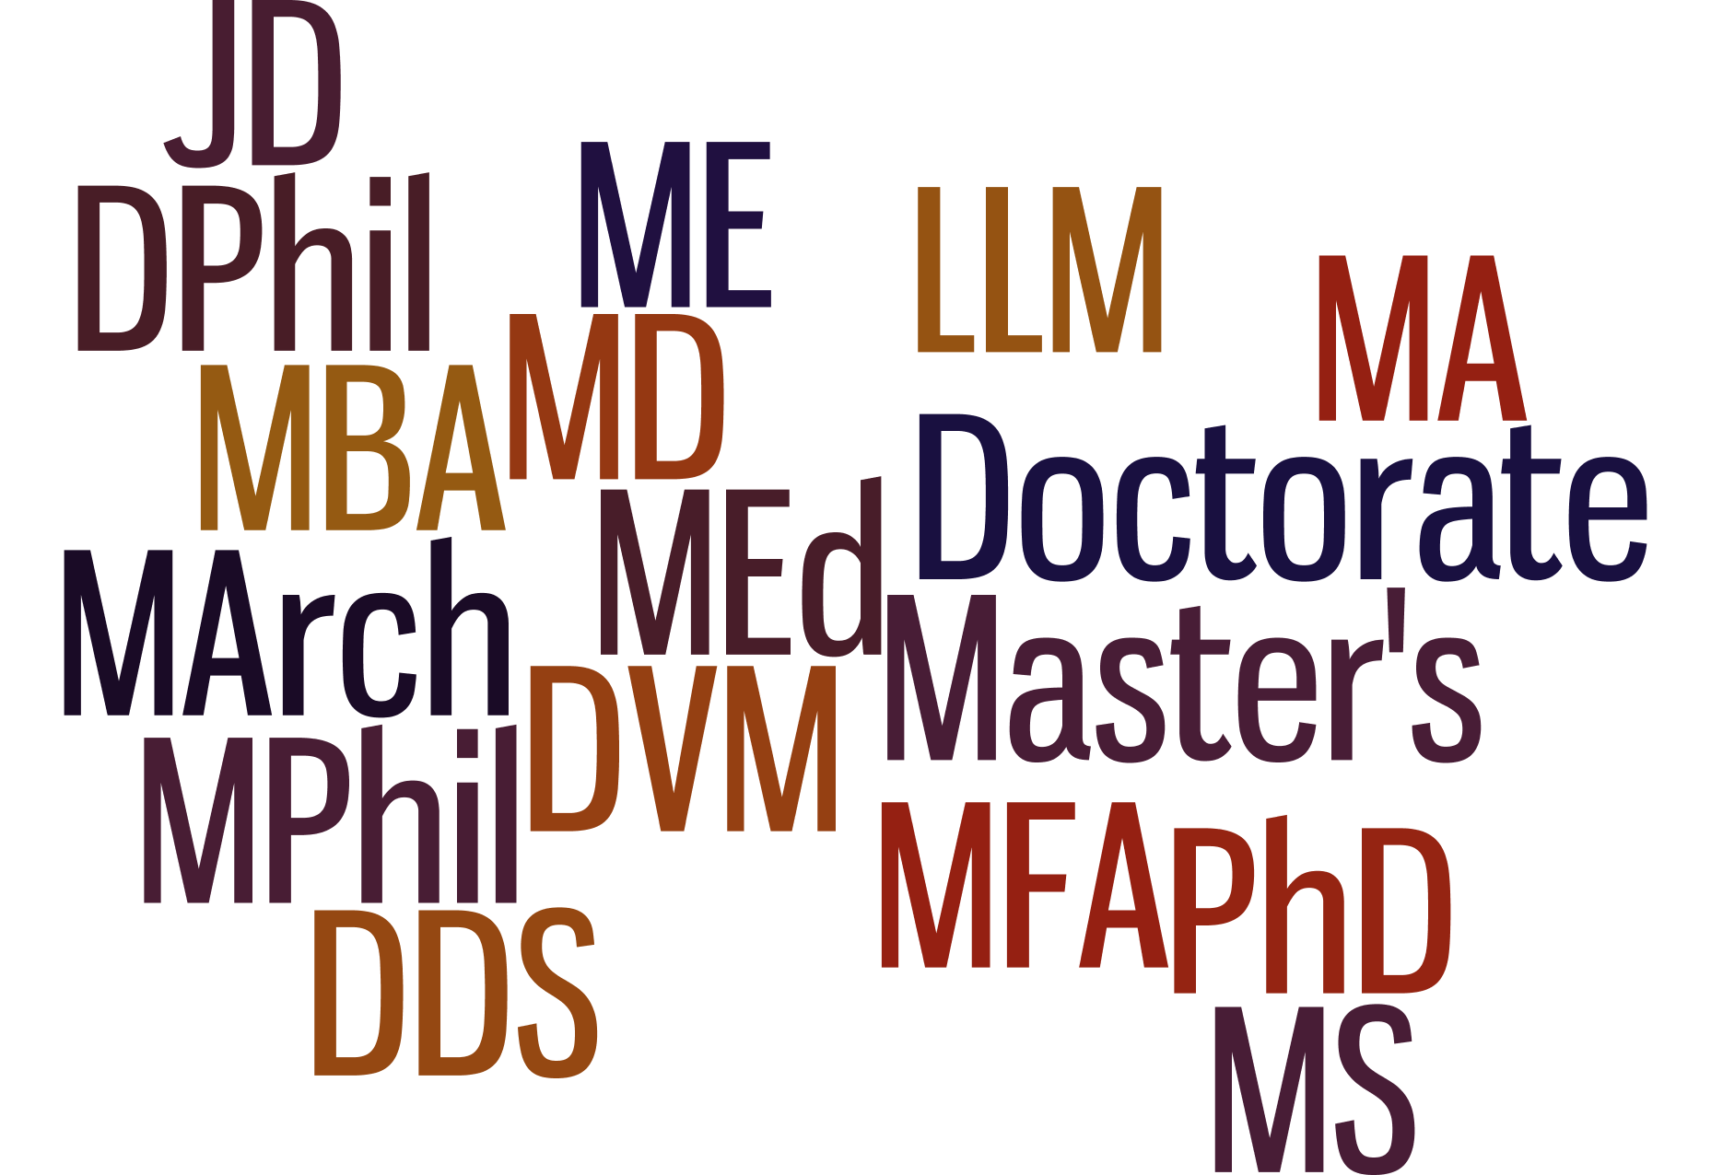
Notes:
There are actually a number of different types of postbacculaureate degrees that students can earn.

Slide 9
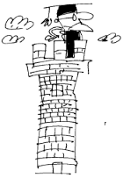
Grad School Basics
Students need the RIGHT degree!
Geologists with PhDs work for oil companies
Architects must have a MArch to be licensed in OH
Small liberal college teachers must have Masters
Notes:
But…..students may need to be reminded that they need to determine which degree is right for them.

Slide 10
Grad School Basics
Application Preparation:
Find the right program and/or advisor
Google yourself!
Contact potential advisors (or program)
Ask respected instructors for suggestions!!
Read current literature
Browse websites
No recent publications
No grad students (unless advisor is new)
NO FORM LETTERS! Make it personal
Notes:
So if I student comes to you and graduate school is an interest, what can you do next. First, suggest that the student look for the right program and/or advisor (this is MUCH different from finding an undergraduate institution). Here are some ways that can be done… But there are a few red flags….
It is also really important to recommend that students Google themselves, just as a potential advisor is likely to do. Do they like what they see about themselves on Facebook or other social media? Is it professional?
Finally, the student should always contact potential advisors (or the program) directly. But this needs to be done in a personalized email.

Slide 11
Grad School Basics
Application Process:
Take the GRE
Ask for letters of recommendation
Apply!
Visit the institution if at all possible
GPA - Transcript
GRE Scores
Letters of Recommendation
Personal Essay
Notes:
Every program is different! The GRE costs $205 right now for the General Test (some disciplines, especially in STEM, may require a subject test, but check first). The GRE is also required by 8 of 10 MBA programs for business (instead of GMAT); the www.ets.org site has lots of free information for students!!
Students must ask faculty and others for STRONG letters of recommendation well in advance (at least 3-4 weeks) or the application deadline.
Apply!
Some programs offer recruiting visits or ask students to come interview on site. Regardless, it is strongly recommend that students always visit the site where they may be spending the next 2-6 years of their life.

Slide 12
Resources on Campus
Notes:
What are other offices doing? These are examples of activities engaging students in thinking about graduate school from around campus.
UC Graduate School (Amy Wheeler): The 2018 GS Conference is scheduled for March 2, 2018 at TUC 4th floor and it would be greatly appreciated if you could share this information with UC advisors at the UC Advising Conference. Our conference is intended for UC undergraduates, tristate university students, and returning adults to educate them on graduate education and resources. Students will explore options - for example why attend Graduate School and what should they study. We will focus on preparing for the Graduate School application - utilizing GRE Test Services, Academic Writing Center, Resume writing, etc. Then applying, Graduate School funding, and UC support services. There will be a registration site, food will be served and there will also be no cost to attend.

Slide 13
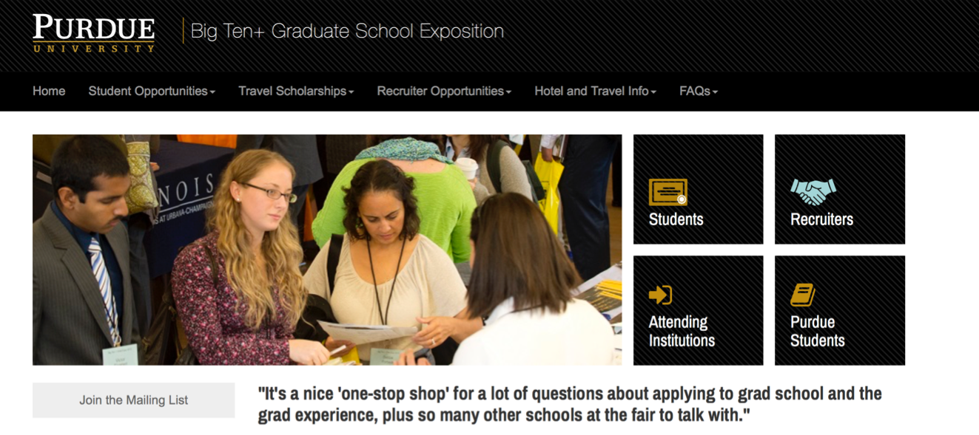
Other Student Opportunities
Notes:
Purdue Big Ten+ Expo occurs in September – a great opportunity for students to learn more about the application process and to meet reps from over 80 programs nationwide.

Slide 14
Final Tips
You Don’t Need to Know It All
Ask good questions
Share basic information
Refer students to the right resources
Notes:
Final Tips

Slide 15
Advisors can help!

