Slide 1
EHSA System
Inspection and Audit
Guide

Slide 2
Table of Contents
Title
Page
03
04
05
06
07
08
09
10
EH&S Lab Safety Audit Results Email ……………………………………….
EH&S Lab Safety Audit Results Email ……………………………………….
Safety Inspections Module ……………………………………………………..
Inspection Response Page ……………………………………………………..
How to Respond to a Finding (Steps 1-5) …………………………………….
How to Respond to a Finding (Steps 6-11) …………………………………...
How to Respond to a Finding (Steps 12-16) ………………………………….
View Inspection History …………………………………………………………

Slide 3
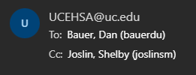
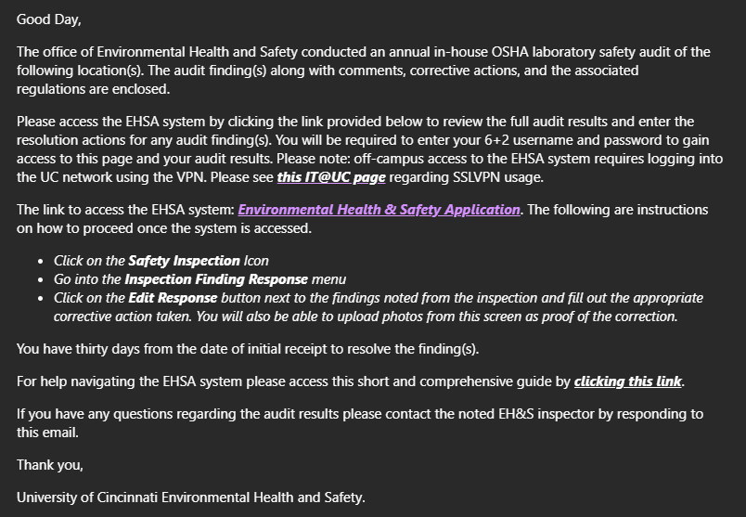
EH&S Lab Safety Audit Results Email
After an inspection has occurred, an email from UCEHSA@uc.edu with the inspector copied, will be sent stating that there are inspection findings for review. The key points in the email are:
PI Email
Inspector Email
The link access the EHSA system to view full audit results
The link to EHSA system training
Instructions on how to enter resolutions to the findings in EHSA system
You can respond to the email to get into contact with the inspector for questions.
03

Slide 4
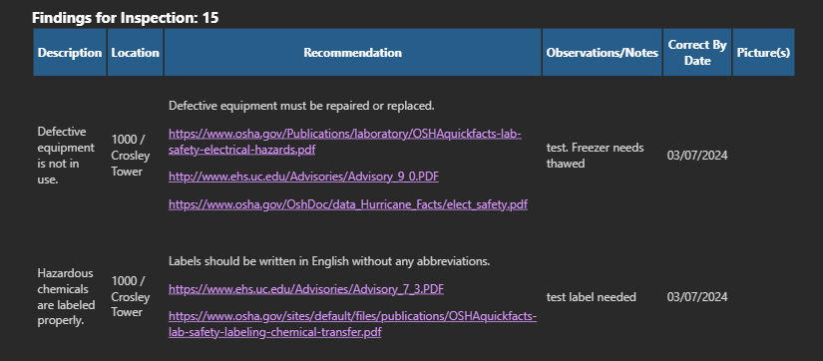
EH&S Lab Safety Audit Results Email
At the bottom of the email, a table of findings will be displayed.
Inspection Number – Every inspection is assigned a unique number and is useful for searching within the EHSA system
Finding Description – a listing of each finding from the inspection
Location – where the inspection took place, and the finding was recorded
Recommendation – If a finding is found, what the recommended course of action might be
Observations/Notes – additional notes given by an inspector
The Correct By Date is an automatically set number of days after the inspection
Pictures associated with each finding
04

Slide 5
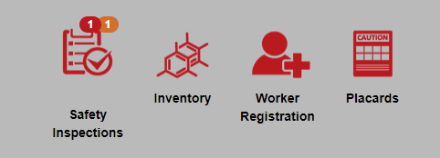
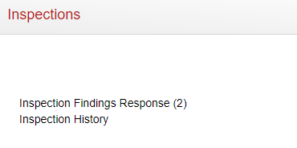
Safety Inspections Module
Whether you click the EHSA system link in the email you received or login to EHSA directly (https://ehsa.uc.edu/EHSA/ ), you will need to navigate to the Safety Inspections module on the EHSA homepage to respond to any findings you may have received.
The Safety Inspections module icon might display red and/or orange notification bubbles above it.
Red – Response Needed
Orange – Pending Approval
In the Inspections section, click Inspection Findings Response.
The number that follows is the total number of findings assigned to you across all inspections.
05

Slide 6
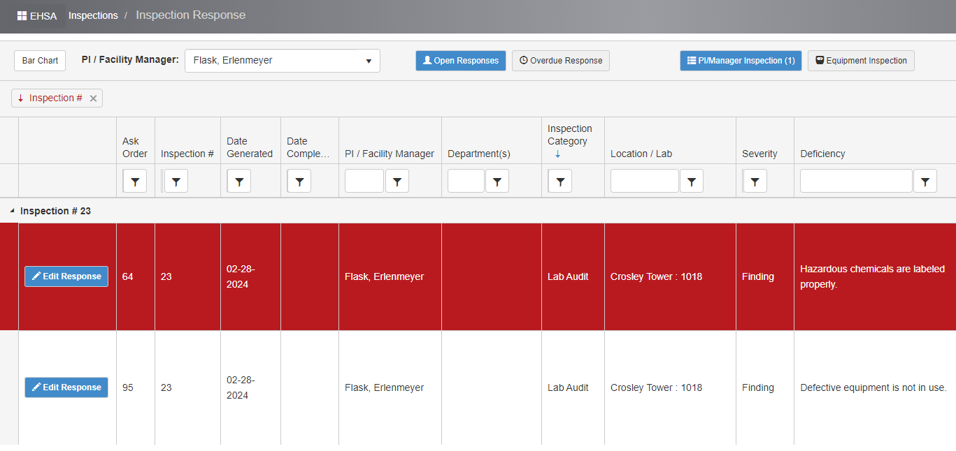
Inspections Response Page
The Inspections Response page displays all inspection findings assigned to you as a PI/Lab Manager.
The findings are organized by Inspection number which matches the number in your email.
You can rearrange columns and apply filters to further organized your findings.
When you are ready to respond to a particular finding, click the Edit Response
button _{Edit Response} to the left of the finding.
06

Slide 7
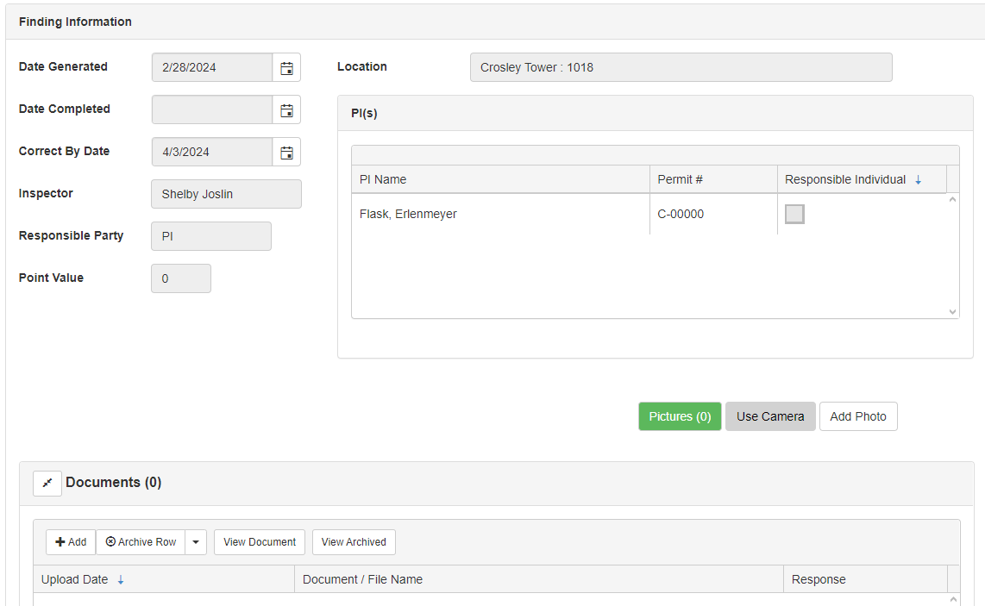
How to Respond to a Finding (steps 1-5)
The Edit Inspections Response page displays the finding’s information such as Location, Date Generated, Correct by Date, Inspector and more.
If the inspector added any pictures, they would be displayed here.
You can also add a photo using the Add Photo
button or button to access the
Use Camera
camera on your device.
If the inspector added any documents to the finding, they would be displayed here.
You also can add documents pertaining to the finding by selecting Add from the Documents section.
07

Slide 8
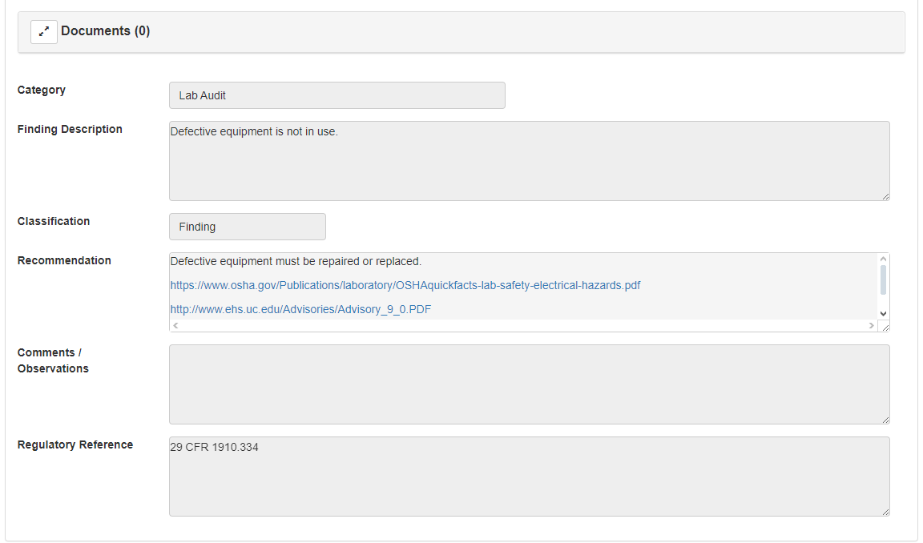
How to Respond to a Finding (steps 6-11)
This is a read-only section of the details of the findings. It will match the email sent out to you along with the information on the Inspections Response Page.
This form contains the following information:
Category – type of inspection
Finding Description – the observed finding during the inspection
Classification – what was observed during the inspection
Recommendation – steps to take provided by the EH&S Inspector
Comments/Observations – additional information from the Inspector
Regulatory Reference – any regulatory information attached to the finding
08

Slide 9
How to Respond to a Finding (steps 12-16)
This section is where you will directly respond to a finding from the inspector.
The following fields are *required:
Describe Corrective Action(s) – the action taken to respond to finding. Images of the resolved finding can also be added.
Response Date – when the corrective action took place
Corrected By – automatically populated by the person performing the corrective action
Once the form is complete, click Save to send this information to the Inspector.
If you have other findings to answer, click
Save and View Next
to send the current info to the
inspector and open the next finding from the inspection.
09

Slide 10
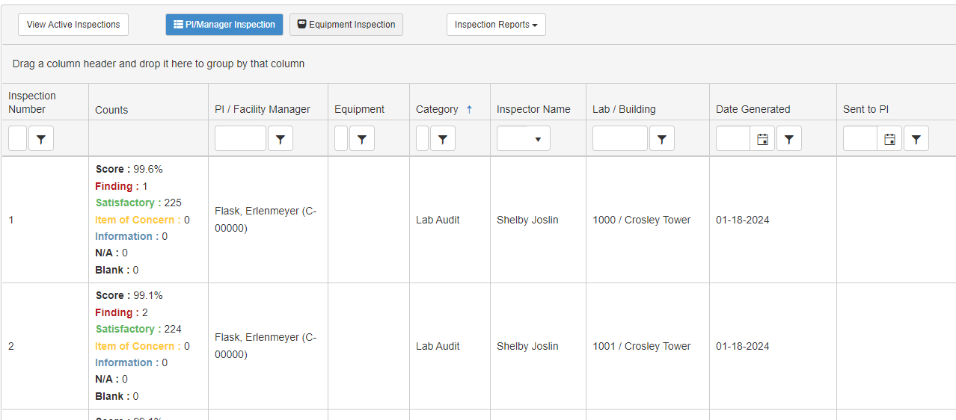
Viewing Inspection History
In the Inspections section, select
Inspection History.
The Inspection History Page will open and by default, all active inspections will be displayed.
If you would like to display the previous inspections, click the View Archived Inspections button.
A report (PDF) can be generated to display an inspection’s findings.
Click the Inspection Reports
dropdown and select a report.
10

Slide 11
EHSA System – Additional Info
Find additional EH&S information
https://www.uc.edu/about/admin-finance/ehs.html
With any questions, concerns or suggestions, contact the
EH&S Audit team - Michael Doust or Shelby Joslin

