Slide 1
Becoming Ballot-Ready
UC Votes
Fall 2026

Slide 2
Objectives
By the end of today’s training, you should be able to:
Check your voter registration status
Register to vote
Choose a voting method and voter ID
Educate yourself on the candidates and issues on your ballot
Vote

Slide 3
1. Check Your Registration Status

Slide 4
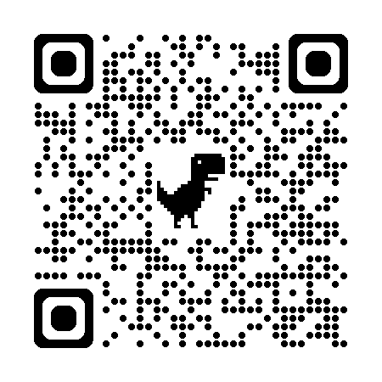
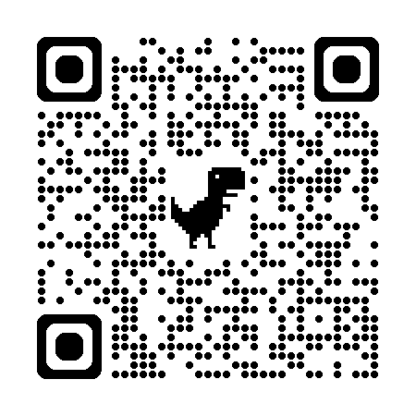
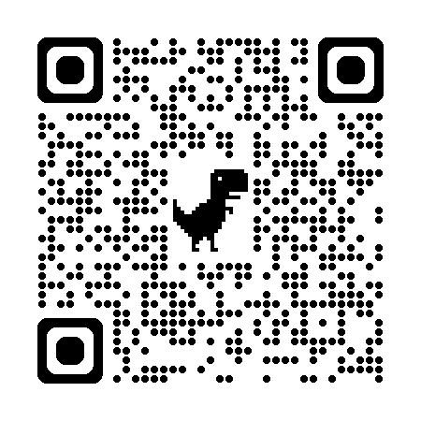
Check Your Voter Registration Status
In most states (including Ohio), you can only vote on Election Day if you are registered to vote by October 5, 2026
If you were previously registered to vote in Ohio and skipped the last general election, you may have been purged from the voter rolls
If you are not sure if you are registered to vote, you should check your voter registration status
All voters should verify their voter registration information annually to verify their status and polling locations
Ohio voters can use the Ohio voter registration lookup tool to check voter registration statuses
Students from all states can use the ALL IN to Vote website or TurboVote to check voter registration statuses
Ohio voter registration lookup
ALL IN to Vote registration lookup
TurboVote

Slide 5
2. Register to Vote

Slide 6

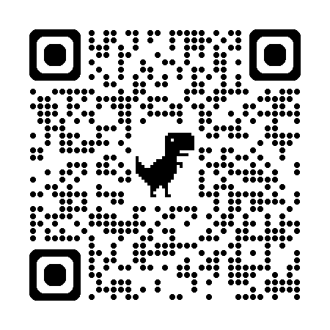

Voter Registration Process: Online
Registering to vote online in Ohio:
  Ohio voters can only register to vote online if they have a state of Ohio identification or driver’s license
  Ohio voters can register to vote online directly through Ohio’s voter registration portal or through third party websites like ALL IN to Vote or Vote.gov
  Information you will need:
    Ohio driver’s license or state ID number
    Name
    Date of birth
    Address
    Last four digits of your social security number
Registering to vote online in another state:
  You can register to vote directly with your state’s online voter registration portal or through third party websites like ALL IN to Vote or Vote.gov.
Ohio’s Voter Registration Portal
ALL IN to Vote
Vote.gov

Slide 7
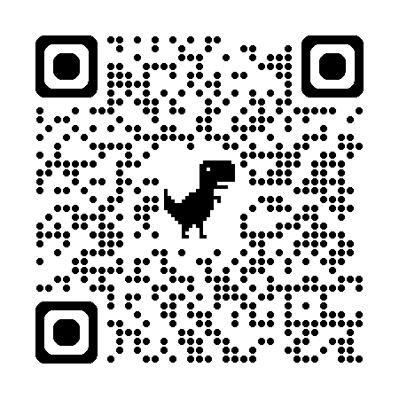
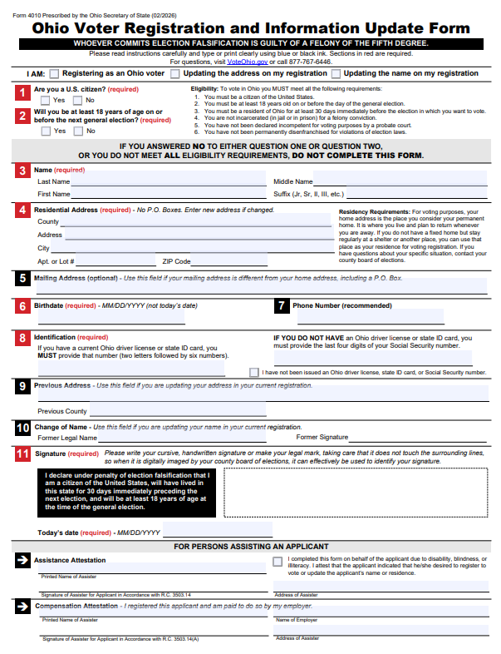
Voter Registration Process: Paper Card
Scan to access form
Registering to vote via paper card
  If you do not have an Ohio identification or driver’s license with your voter registration address on it, you will likely need to register to vote with a paper voter registration card
  You can print out a PDF version of Ohio’s voter registration card online (top QR code to the right)
    Copies can also be found in the UC Votes space in the undergraduate student government office in Steger 655
  Once you complete your voter registration card, it should be mailed to or dropped off at your county’s Board of Elections or it can be dropped off at the the undergraduate student government office in Steger 655

Slide 8
Voter Registration Process: Paper Card (2)
Scan to access form
Ohio voter registration card:
  Use blue or black ink only; boxes highlighted in red are required
  Check a box next to “I am”, next to #1, and #2
  If you are a first-time voter, you will fill out numbers 3-8 and 11
  You will only fill out 9 or 10 if you were previously registered to vote in Ohio with a different address or name
  Check #4: You should have written down your COUNTY and NOT USA
  Check #6: This should be your birthday and not today’s date
  Check #7: Voters are encouraged to provide contact information in case something is wrong with the form (but this is not required)
  Check #11: Signature should be replicable and entirely located within the box; today’s date should be listed below (not your birthday)
  Needs to be mailed to or dropped off at your county’s Board of Elections

Slide 9

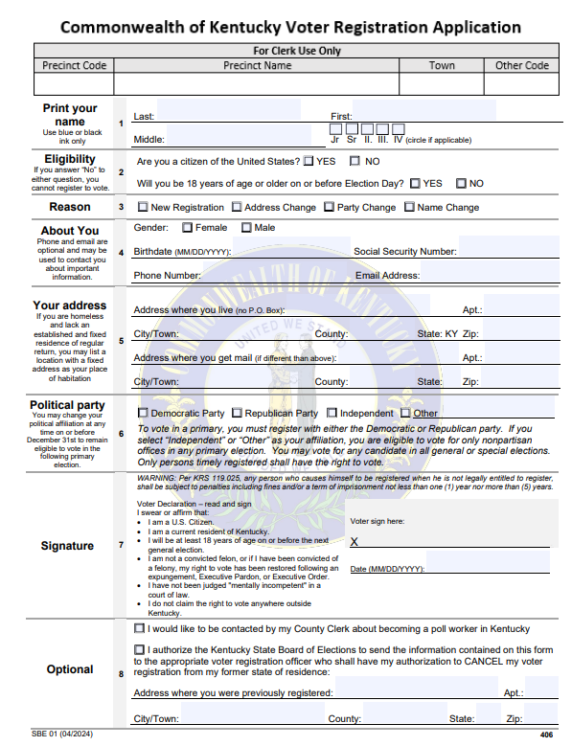
Voter Registration Process: Paper Card (3)
Scan to access form
Kentucky voter registration card:
  Use blue or black ink only
  Follow the numbers
  Check #4: You must check female or male; make sure a birthday is listed instead of today’s date; there must be a social security number
  Check #6: Primary elections are elections within political parties; Kentucky’s primary elections are closed, meaning you must be previously affiliated with a political party in order to vote in a primary election (however, if you don’t want to vote in Kentucky’s primary elections, you do not need to affiliate with a political party)
  Check #7: Is your signature replicable and located completely within the signature box? Did you write down today’s date under their signature (NOT your birthday)?
  Check #8: Consider serving as a poll worker; if you were previously registered in another state, you can check a box to have the State Board of Elections cancel your old voter registration
  Fold the form in half, close it with tape, add a stamp, and put it in the mail! The address is already listed on the back.

Slide 10
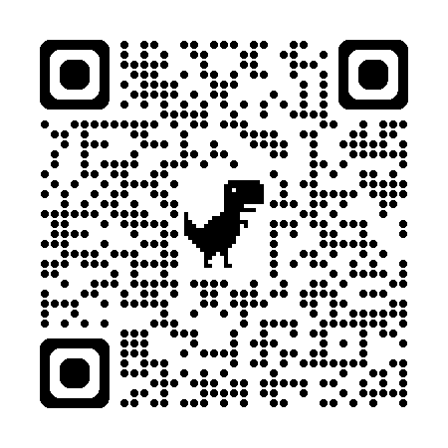

Voter Registration FAQs
Q: Can I register to vote today if I am currently 17 years old?
  A: You can register to vote today provided you will be 18 years old by Election Day
Q: Is there a deadline to turn in a voter registration card?
  A: The voter registration deadline in Ohio is one month prior to Election Day
Q: Can an out-of-state student register to vote with an address that is being used for school purposes?
  A: Yes. Students must choose between registering to vote with their home/ permanent address OR an address they are using for school purposes.
    Registering to vote with a school address would replace any previous voting address. It is illegal to register or vote from more than one address.
    If you register to vote with an address you are using for school purposes and if you move to a new residence next academic year, you will need to update your voter registration information next year
    More information on voting as a college student in Ohio can be found by scanning the bottom QR code to the bottom right
Q: What addresses should students use if they want to register to vote with a campus address?
  A: Physical addresses of campus housing facilities can be found on the UC Votes website or by scanning the QR code to the top right
UC Votes Website
Information on voting as a college student in Ohio from the Ohio Secretary of State

Slide 11
3. Choose Voting
Method & Voter ID

Slide 12


Early Voting
There are 3 ways to vote in Ohio:
1: Voting early in-person
  Could be useful for students who don’t plan on having time to vote in-person on Election Day
  In Ohio, early voting takes place at county Board of Elections starting one month before Election Day (October 6, 2026)
  You must provide a valid form of ID to vote early in-person (Ohio identification, military ID, or passport)
  The early voting schedule can be found on the Ohio Secretary of State’s website
  The Greater Cincinnati Voter Collaborative partners with RideShare2Vote to provide free rides to polling locations during the early voting period and on Election Day
Hamilton County Board of Elections
Ohio’s Early Voting Schedule

Slide 13
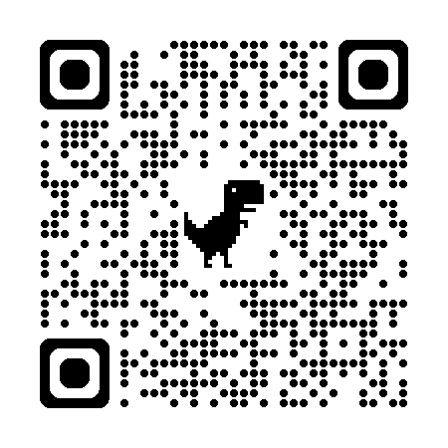
Voting by Mail
2: Voting by mail
  Could be useful for students who don’t have access to a valid state of Ohio ID or a passport because it only requires you to document the last 4 digits of your social security number
  Students who wish to vote by mail must first complete an absentee ballot application (top QR code to the right)
    Copies can also be found in the UC Votes space in the undergraduate student government office in Steger 655
    This form can be returned by mail or dropped off in-person at your county Board of Elections office
    The form can also be left with UC Votes at the UC Votes space in the undergraduate student government office in Steger 655
  If you live on campus, refer to the UC Votes page to identify the mailing address for your absentee ballot application (bottom QR code to the right)
Absentee ballot application
UC Votes Website

Slide 14
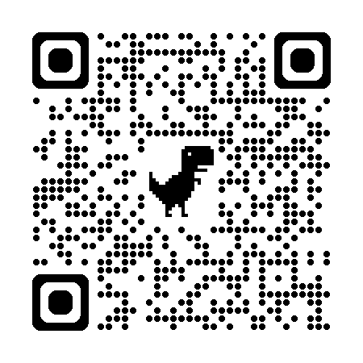
Voting by Mail (2)
2: Voting by mail
  Absentee ballots can be tracked via county board of elections’ ballot tracker tools; scan the QR code to the right to begin tracking your absentee ballot
  Once you receive your absentee ballot in the mail, you may wish to fill it out as soon as possible to ensure that it arrives via USPS by 7:30PM on Election Day
  Carefully follow the instructions on their ballot as you will be required to provide signatures and the last four digits of your social security number
  To turn in your voted absentee ballot, you will either mail it via USPS to your Board of Elections or you can drop it off in-person at your Board of Elections by 7:30PM on Election Day
  If you turn in your voted ballot via USPS, you will need put the correct number of stamps on your absentee ballot envelope (one stamp per page of ballot)
    Stamps can be purchased at the Corryville Post Office
Absentee ballot tracker

Slide 15
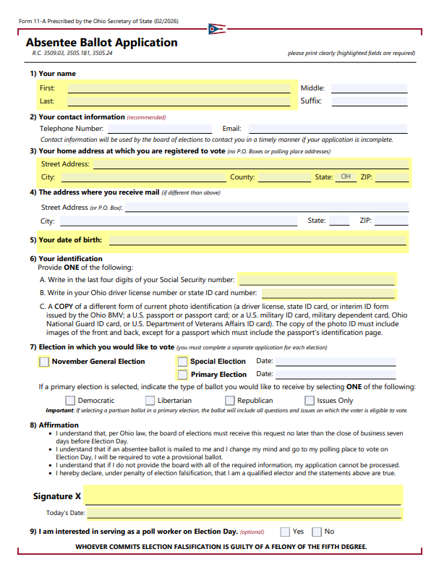
Voting by Mail (3)
Absentee ballot application
2: Voting by mail
  When filling out the application, use blue or black ink
  Voters can’t request an absentee ballot for a primary election and the general election using the same form
  Voters are encouraged to provide contact information in case something is wrong with the form
  Required aspects are highlighted in yellow; follow the numbers
  Check #3: Did your write down your COUNTY or USA?
  Check #6: Did you provide a form of identification?
  Check #7: Did you check the November General Election box?
  Check #9: Voters are encouraged to serve as a poll worker; poll workers earn about $200 for working election day but can only work in the county in which they are registered to vote (this box is optional)
  Reminder: Needs to be mailed to or dropped off at your county’s Board of Elections

Slide 16
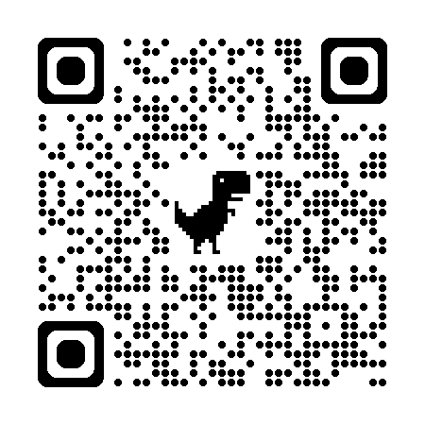
Voting On Election Day
3: Voting In-person on Election Day
  Polls in Ohio are open from 6:30AM-7:30PM on Election Day
  Before you go to your polling location to vote on Election Day, confirm both your voter registration and your polling location
  You must provide a valid form of voter ID to vote in-person on Election Day
  The Greater Cincinnati Voter Collaborative partners with RideShare2Vote to provide free rides to polling locations during the early voting period and on Election Day
  You may have to wait in line to vote
    If you are in line at 7:30 PM (in Ohio), do NOT leave the line; you have the right to stay in the line as long as needed to vote
    Bring anything you might need while you wait in line (water, snacks, etc.)
  If your voter eligibility is questioned at the polls, you can still vote using a provisional ballot
    Provisional ballots look the same as regular ballots, but are set aside until election officials confirm voter eligibility and that the ballot was cast in the correct precinct
    You may have to request the provisional ballot from the poll worker
    For your provisional ballot to count, you must appear in-person at your Board of Elections within 4 days of Election Day to provide proof of identity
    Learn more about provisional voting via the Ohio Secretary of State's website
  If you experience issues while voting, or if you need voting information, consider calling the Election Protection Hotline at 1-866-OUR-VOTE (English), 1-888-Ve-Y-Vota (Spanish), 1-844-YALLA-US (Arabic), 1-888-API-VOTE (Asian & Pacific Islander languages).
More info on provisional voting

Slide 17
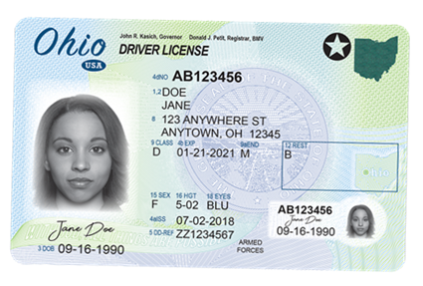

Voter Identification
You will need to bring a voter identification if you vote early in-person at your Board of Elections OR if you vote in-person on Election Day
The following are the only acceptable forms of voter ID in Ohio:
  Unexpired Ohio driver's license: commercial, motorcycle, probationary, interim, temporary, or restricted
  Unexpired Ohio issued ID card-- will be issued by the state for free**
  US military ID card
  Ohio issued National Guard ID card
  US issued Department of Veterans Affairs ID card
  Unexpired US passport or passport card

Slide 18

Voter Identification (2)
The address on the voter identification does not need to match the voter’s registration address; it just needs to be a valid form of identification
If you need an identification: the Ohio BMV will issue free state identifications to anyone 17 years of age or older
  Out of state students who are registered to vote in Ohio who get a free Ohio ID will have their home state license revoked
  Keep in mind: Out of state students who register to vote in Ohio can vote by mail with the last four digits of their social security number or in-person with a passport
  VoteRiders, a nonpartisan nonprofit, will help anyone get a free voter identification
VoteRiders

Slide 19
4. Voter Education

Slide 20
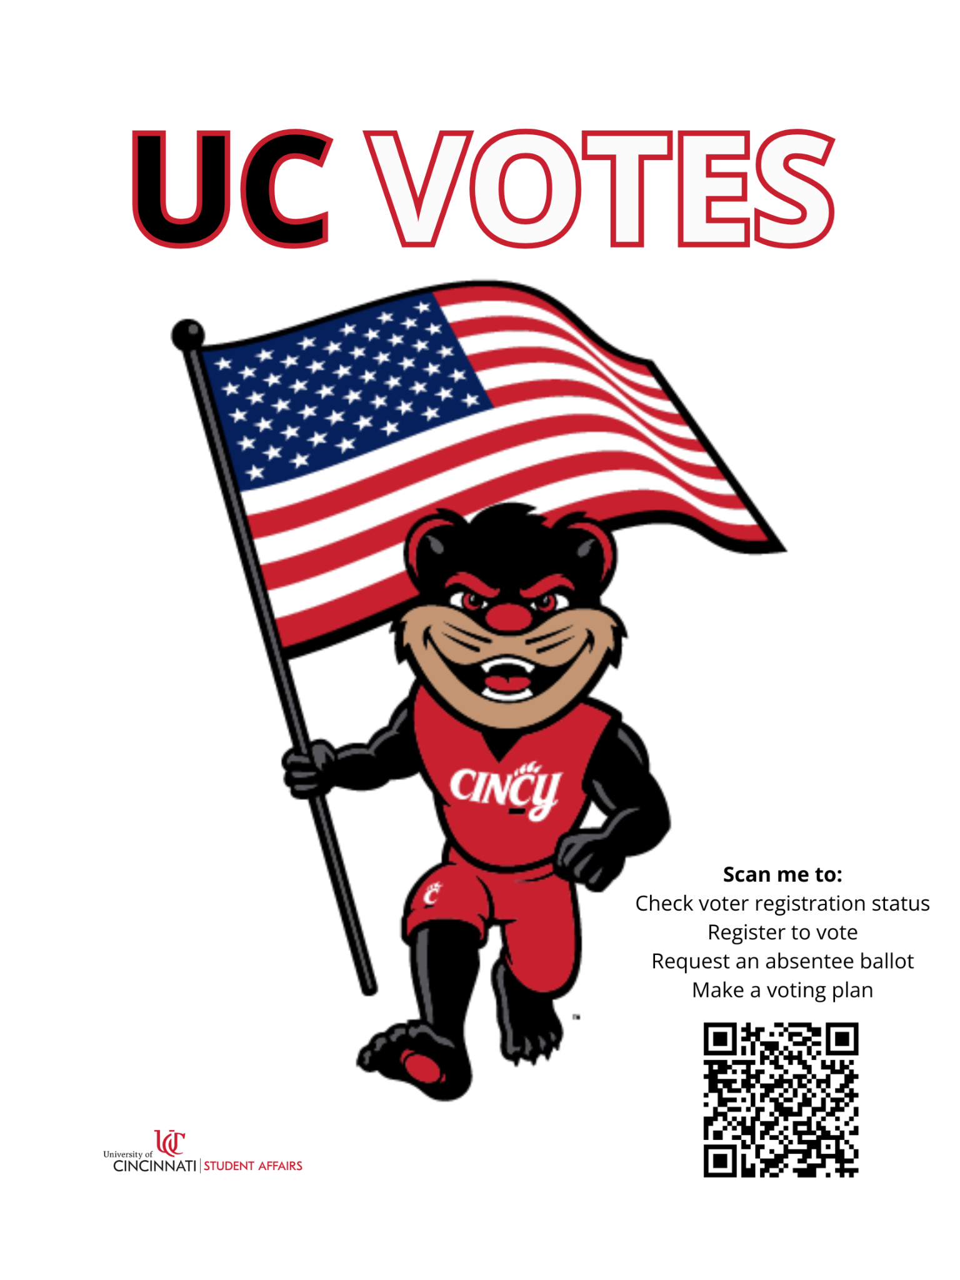
UC Votes Website
Check out our UC Votes website
  Key election dates
  UC Votes events
  UC Votes presentation request form
  Steps to becoming ballot-ready
  And more!

Slide 21
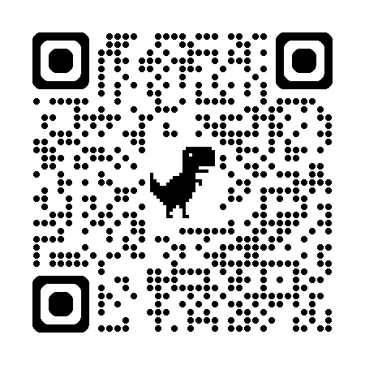
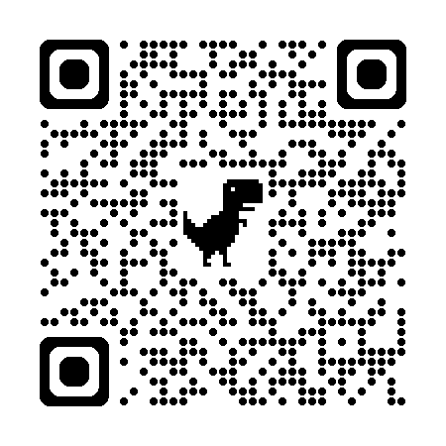
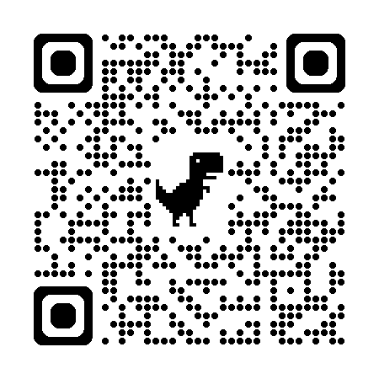
Nonpartisan Voter Guides
The League of Women Voters of Cincinnati Area offers a comprehensive nonpartisan voter guide for Hamilton County for federal elections
  You can use this to learn more about the candidates and issues on the ballot
  This voter guide is usually published at the beginning of October.
WVXU offers a regional voter guide every election cycle, including information about statewide races and county-specific races.
Guides.vote offers nonpartisan voter guides for races across the country.
League of Women Voters of Cincinnati Area
WVXU
Guides.vote

Slide 22
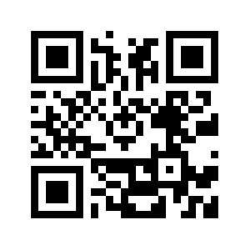
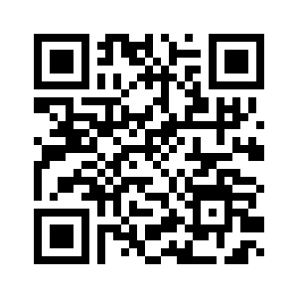
Sample Ballots
VOTE411.org has a great sample ballot tool, which will populate almost everything on anyone’s ballot
Hamilton County residents can view their sample ballots via the Hamilton County Board of Elections’ website
You can use both tools starting about 45-30 days before Election Day
Vote411.org
Hamilton County Board of Elections

Slide 23
Conclusion
Now that you checked your voter registration status, registered to vote, selected your voting method/ voter ID, and educated yourself on what will be on your ballot, you are ready to vote!
Are you able to:
Check your voter registration status?
Register to vote?
Choose a voting method and voter ID?
Educate yourself on the candidates and issues on your ballot?
Vote

Slide 24

Questions?
Keith Lanser
Associate Director
Center for Community Engagement
keith.lanser@uc.edu

