Slide 1
Advising Strategic Plan
University of Cincinnati
August 10,2015

Slide 2
Importance of Advising to UC Students

Slide 3
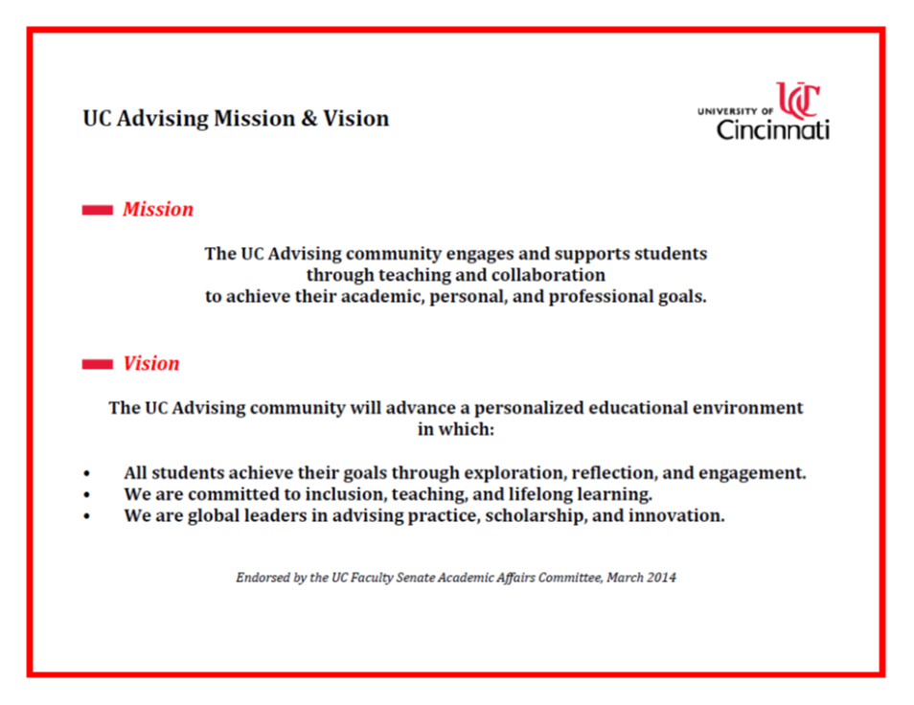
UC Advising Mission & Vision

Slide 4
UC Advising Community
Academic Advisors – College-Based
College academic advisors provide the primary advising support to students. Some college advisors also have a specialized advising role.
Academic Advisors - Specialized
Pathways Advising
  Exploratory
  Pre-professional
  Transfer/transition
  Dual enrollment
  Non-matriculated
Targeted Program Advising
  Athletics
  Honors
  Nat’l. Competitive Awards
  Others
College
Academic Advisors
(professional and faculty)
Specialized Academic Advisors (Pathways Advising or Targeted Programs)
Related Academic/Career Support
Advising & Academic Services
Professional Practice & Experiential Learning
Career Development
First Year Experience & Learning Communities
Academic Excellence & Support Services
  Tutoring
  Coaching
  Supplemental Instruction
Additional student service & student affairs programs
  One Stop
  Registrar
  International
  Gen One
  Cincinnati Pride
  Residence Educ. & Development
  Others
Related Academic/Career Supports
Though the core of the
UC Advising Community is academic advisors, it is also inclusive of those who provide other academic or career-related support.

Slide 5
Task Force

Slide 6
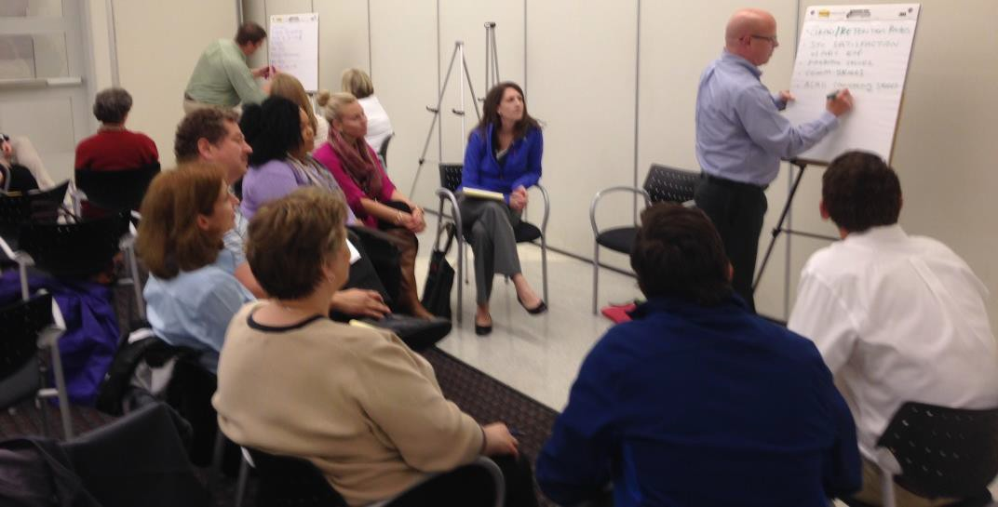
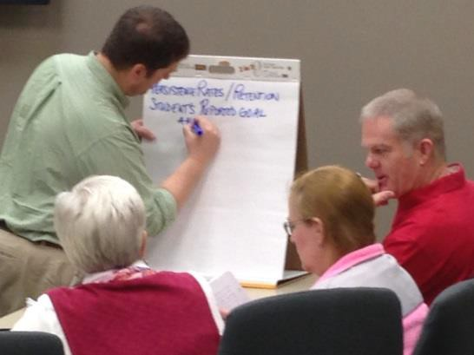
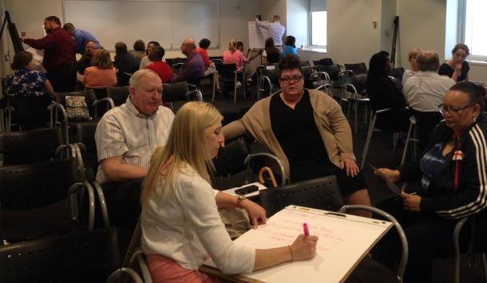
Developing an
Advising Strategic Plan

Slide 7
Strategic Plan Goals
Goal 1 | Advising Practice Model exemplary advising practices for all UC students across the advising community
Goal 2 | Specialized Advising Model exemplary practices for specialized student advising needs
Goal 3 | Coordination Maximize the impact of advising resources for all students through coordination and assimilation of efforts throughout the advising community
Goal 4 | Quality Invest in quality student advising through advisor recruitment, hiring, retention, training, and development
Goal 5 | Assessment Become an industry leader in assessment of student advising practices

Slide 8
Goal 1 – Advising Practice
Strategy 1: Technology-Facilitated Success Network
Utilize enterprise technology to facilitate each student’s contact with their student success network, document individual progress, and coordinate effort
Strategy 2: Advising Continuity for Students
Ensure that academic advisors of declared students can advise on a student’s entire program curriculum from entrance to graduation
Strategy 3: Advising Syllabus
Publish an advising syllabus to ensure clarity about the roles of advisors and students
Strategy 4: Faculty Mentorship
Ensure that all students have a faculty advisor as part of the student success network to address specific field-related issues
Strategy 5: Peer Advisor/Mentor Training
Include peer academic advisors in proposed Peer Education Network training and initiatives

Slide 9

Goal 2 – Specialized Advising
Strategy 1: Reinforce Specialized Advising
Ensure that specialized student advising needs are supported by advisors with expertise in that content area
Strategy 2: Partnership and Connection
Create intentional partnerships and knowledge sharing between the specialized advising units and other units through a liaison model
Strategy 3: Integrated Orientation
Ensure that tailored orientations for any special student populations are integrated with an overall university orientation and welcome program

Slide 10
Goal 3 - Coordination
Strategy 1: Assigned Advisors and Coordination
Assign at least one advisor to every student and coordinate advising teams where needed
Strategy 2: Standardized Outcomes
Develop and maintain standardized advising outcomes
Strategy 3: Common Advising Terminology
Create and utilize a glossary of standard advising terms to be used across advising programs
Strategy 4: Relationship & Communication
Strengthen relationships and communication between campuses, departments, faculty advisors, advising units, student services, and student affairs units
Strategy 5: Technology for Accessibility
Utilize technology to the fullest to provide advisor accessibility for students, student’s and advisors’ access to information, and documentation of student advising
Strategy 6: Early Alert
Create, implement, and sustain an early warning/alert system
Strategy 7: Career Advising
Integrate career planning into advising and strengthen support for career decision-making

Slide 11
Goal 4 - Quality
Strategy 1: Student-Advisor Ratios
Establish and maintain student-to-advisor ratios that align with best practice national standards
Strategy 2: Diversity and Inclusion
Promote diversity and inclusion within the advising community through recruitment, hiring and training practices
Strategy 3: Advisor Training & Orientation
Utilize technology to provide a formalized orientation and training program for new and experienced advisors
Strategy 4: Leadership Development
Provide training and development for advising administrators, advising leaders, and those aspiring to such roles
Strategy 5: Career Path
Advising units will utilize the standardized advising career trajectory for advising as prescribed by the
UC Human Resources Office
Strategy 6: Advising Website & Manual
Improve, expand, and continually develop the advising website and manual as a resource for advisor development
Strategy 7: Accessibility of Professional Development
Ensure access and financial support for professional and faculty advisors, to participate in quality, innovative professional development opportunities supported by the goals and strategies of the Advising Strategic Plan

Slide 12
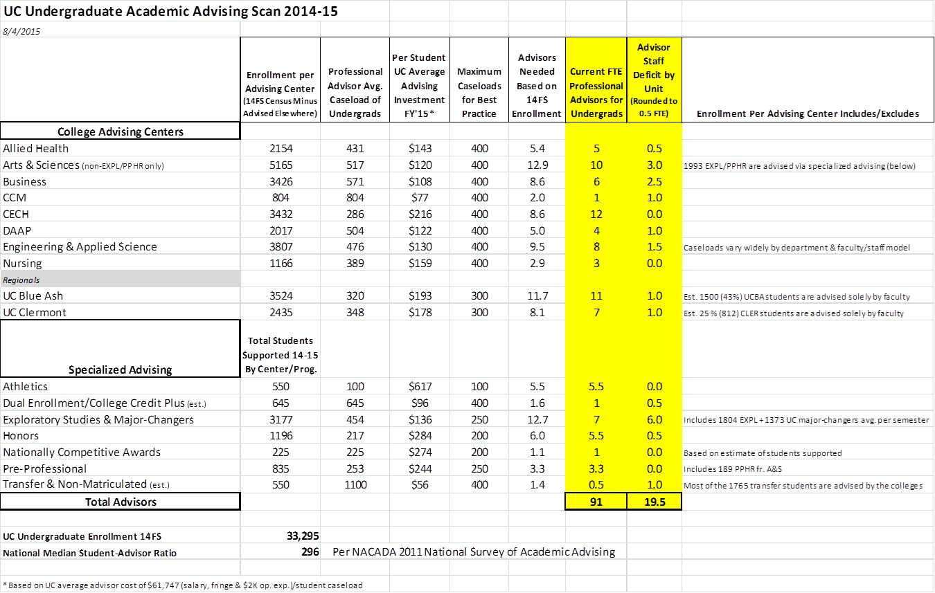
Advising Scan

Slide 13

Goal 5 - Assessment
Strategy 1: Data Tracking
Align tracking of advising activity for better data collection and assessment of advising
Strategy 2: Assessing Outcomes
Regularly assess and document key advising outcomes, including:
  ·Retention/graduation rates of all student populations including special populations (transfer, transition, dual-enrollment, international, athletics, exploratory, honors, etc.)
  ·Standardized university-wide advising outcomes as identified in the advising assessment plan
  ·Individual unit advising outcomes as identified in the advising assessment plan
Strategy 3: Advisor Effectiveness
Identify student learning, process and delivery outcomes to assess advisor effectiveness

Slide 14
Budget – Part I

Slide 15
Budget – Part II

Slide 16

Next Steps
Share the Advising Strategic Plan with the Advising Community
Refine Goals/Strategies
Share the plan broadly with the larger University community

Slide 17

Questions?

